Slide 1
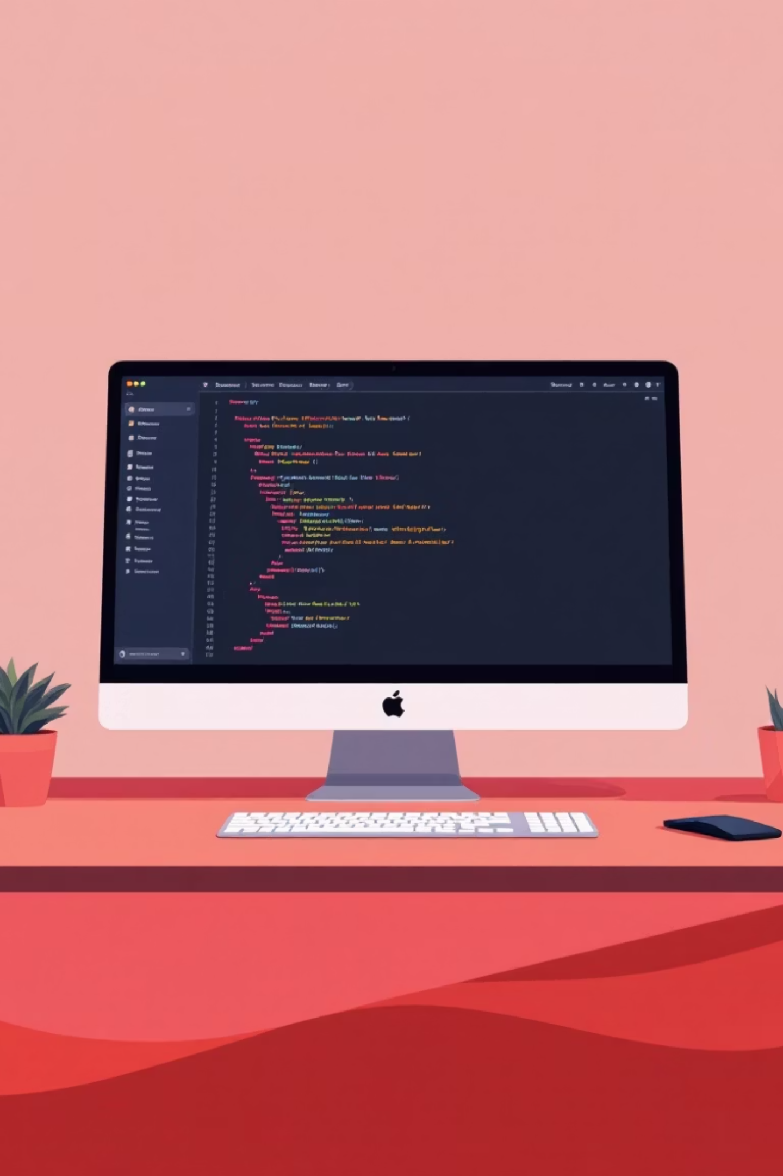
CSS Flexbox Layout System
A modern way to build responsive layouts for today's web
Presenter
Connect
Ankit MauryaMobile: 8303861034Email: ankitmaurya.tech@gmail.com
LinkedIn ProfileGitHub Portfolio

Slide 2
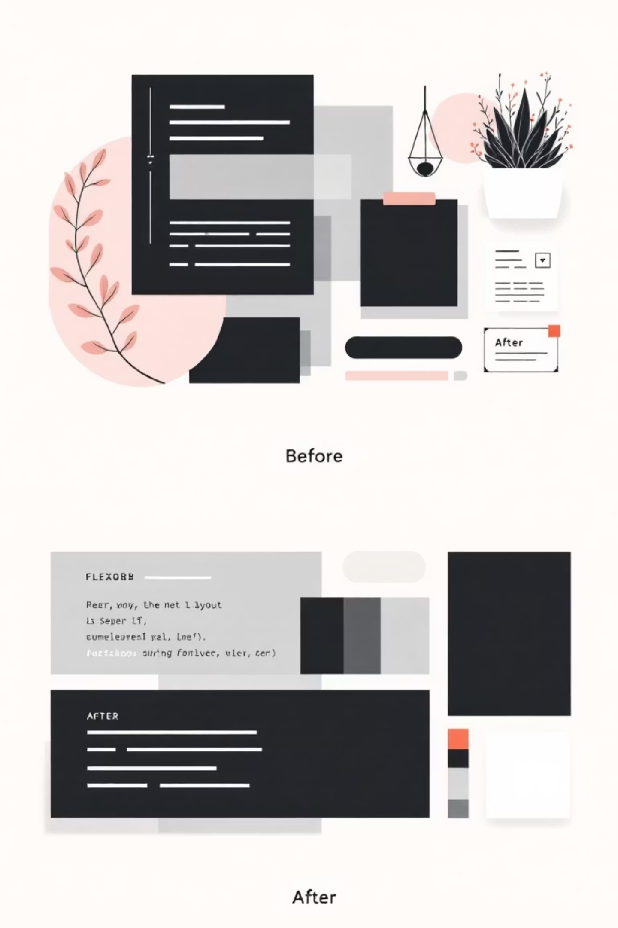
What is CSS Flexbox?
Flexible Box Layout
Modern Solution
A powerful CSS layout method that makes it easy to align and distribute space among items in a container, even when their size is unknown.
Replaces outdated float and inline-block techniques with a clean, intuitive approach to building responsive layouts.
Developer-Friendly
Solves common layout challenges like vertical centering, equal-height columns, and flexible spacing with simple CSS properties.

Slide 3

Flex Container & Flex Items
The Foundation
HTML Structure
Flex Container: The parent element with display: flex;
<div class="container"> <div class="item">Box 1</div> <div class="item">Box 2</div> <div class="item">Box 3</div></div>
Flex Items: Direct children inside the container
Once you apply display: flex to a container, its children automatically become flex items with special layout powers.
CSS
.container { display: flex;}

Slide 4
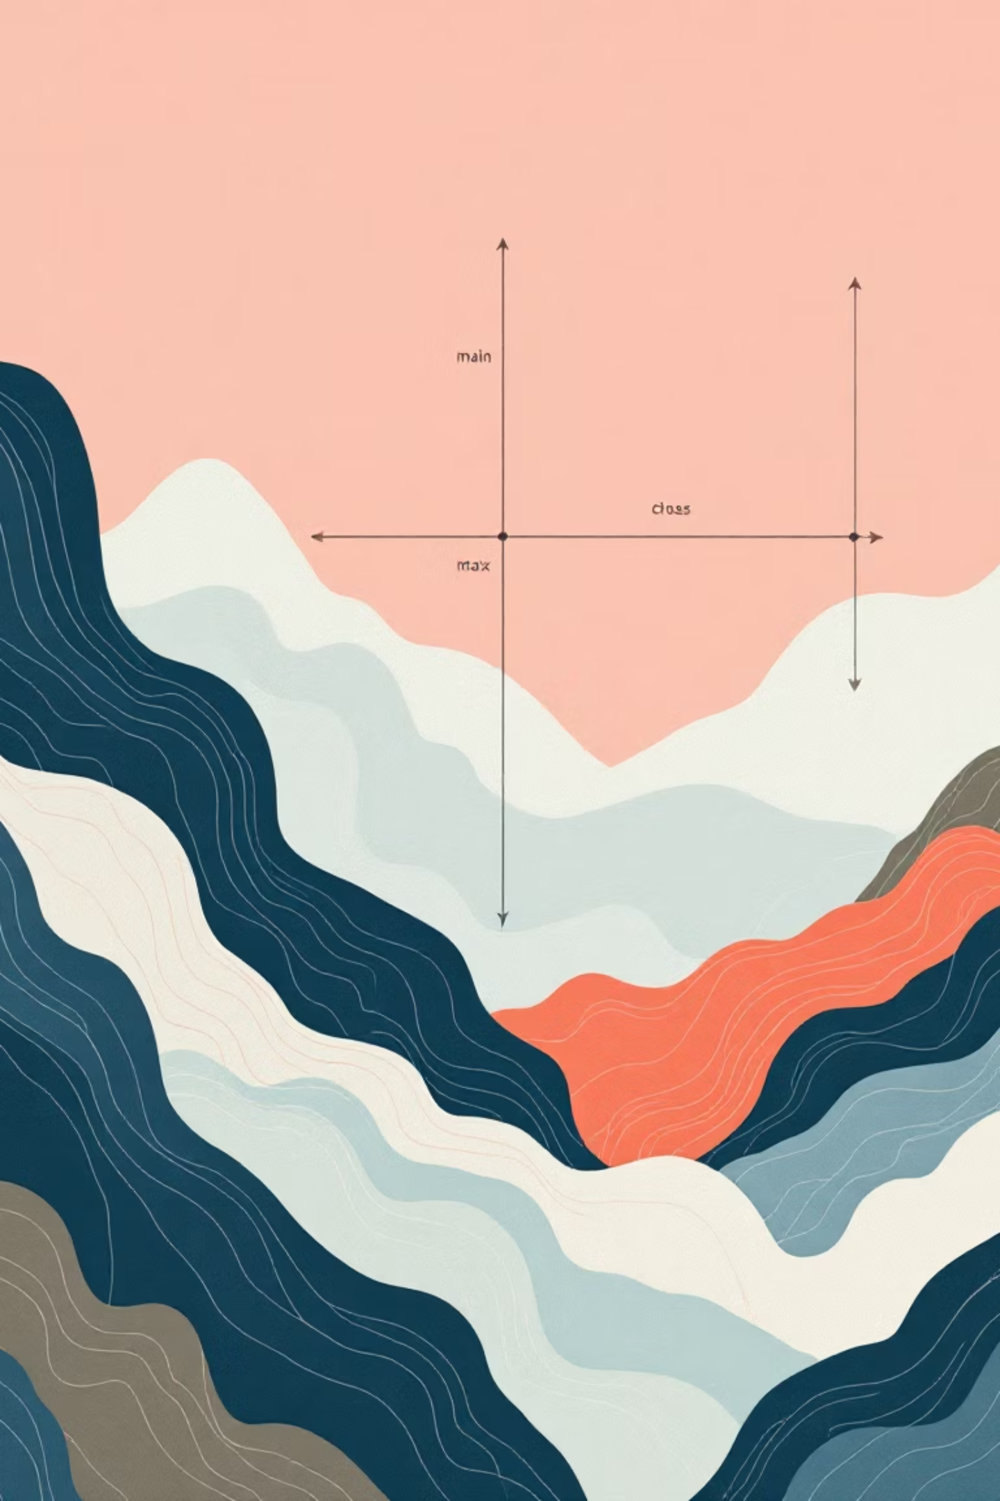
Understanding Flexbox Axes
Main Axis
The primary axis along which flex items are laid out. By default, this runs horizontally from left to right (row direction).
Cross Axis
The axis perpendicular to the main axis. By default, this runs vertically from top to bottom.
Key Insight: When you change flex-direction to column, the axes flip - main becomes vertical, cross becomes horizontal.

Slide 5

Flex Container Properties
Master these properties to control how flex items behave inside their container:
Property
Purpose
flex-direction
Sets direction of items (row, column, row-reverse, column-reverse)
justify-content
Aligns items along the main axis (start, center, space-between, etc.)
align-items
Aligns items along the cross axis (stretch, center, flex-start, etc.)
flex-wrap
Controls whether items wrap to new lines (nowrap, wrap, wrap-reverse)
align-content
Aligns wrapped lines of items
.container { display: flex; flex-direction: row; justify-content: space-between; align-items: center;}

Slide 6
Flex Item Properties
Control individual flex items with these powerful properties:
1
2
flex-grow
flex-shrink
Defines how much an item should grow relative to other items. Default is 0 (no growth).
Defines how much an item should shrink when space is limited. Default is 1.
3
4
flex-basis
flex (shorthand)
Sets the initial main size of an item before free space is distributed.
Combines grow, shrink, and basis into one property. flex: 1; is common.
.item { flex: 1; padding: 10px;}.item:nth-child(2) { align-self: flex-end;}

Slide 7
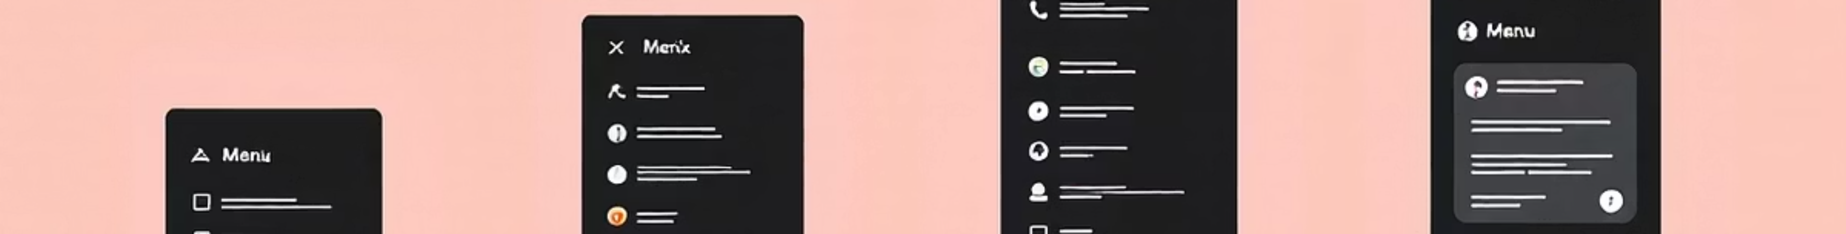
Practical Navigation Example
HTML Structure
CSS Styling
<div class="container"> <div class="item">Home</div> <div class="item">About</div> <div class="item">Contact</div></div>
.container { display: flex; justify-content: space-between; align-items: center; background: #f4f4f4; padding: 10px;}.item { padding: 10px; background: lightblue; border-radius: 4px;}
This creates a perfectly spaced navigation bar that automatically adapts to different screen sizes!

Slide 8
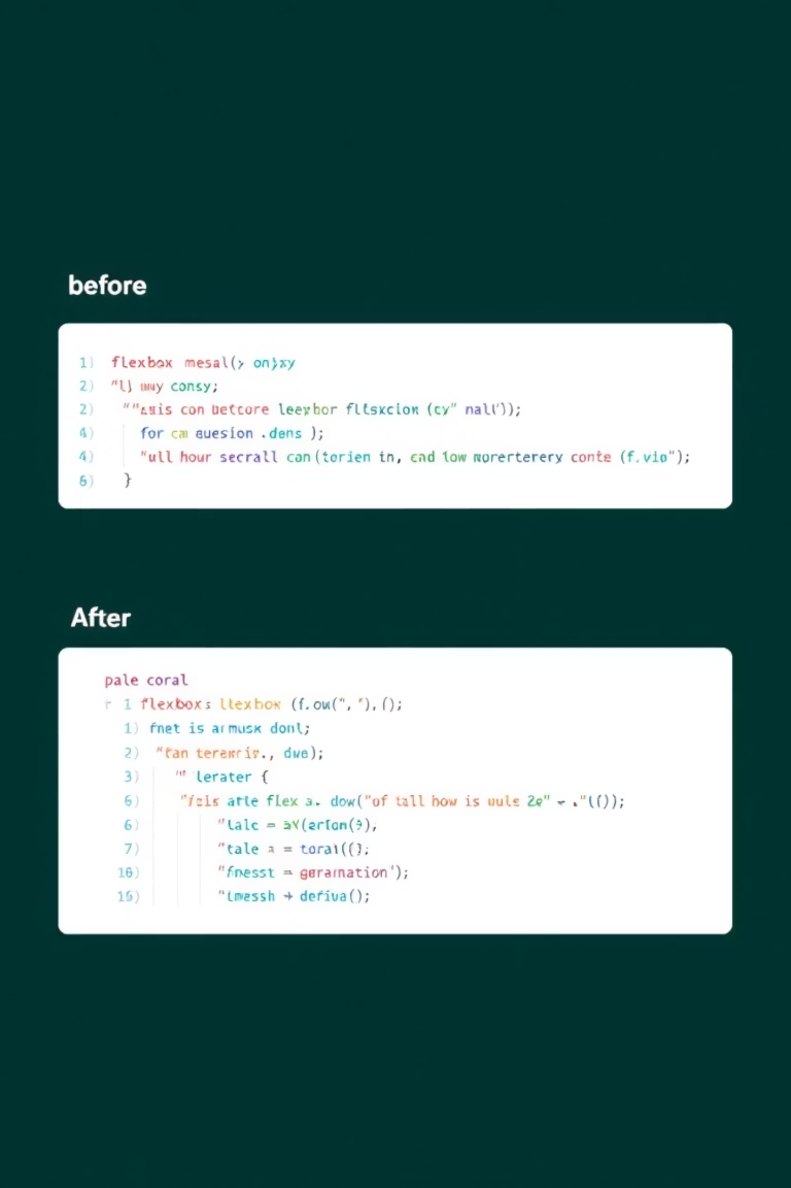


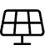

Why Choose Flexbox?
Perfect Alignment
Easily center content both vertically and horizontally with just two properties.
Responsive by Nature
Automatically adjusts to different screen sizes without media queries.
Cleaner Code
Eliminates complex float clearfixes and positioning hacks.
Mobile-First Ready
Perfect foundation for modern responsive web design patterns.

Slide 9




Real-World Applications
Flexbox shines in these common web development scenarios:
Navigation Bars
Card Layouts
Create horizontal or vertical navigation menus that distribute space evenly and align perfectly.
Build flexible card grids that adjust to content length and screen size automatically.
Form Design
Dashboard Panels
Align form elements, labels, and buttons with precision and consistent spacing.
Create flexible dashboard layouts with resizable panels and perfect content alignment.

Slide 10
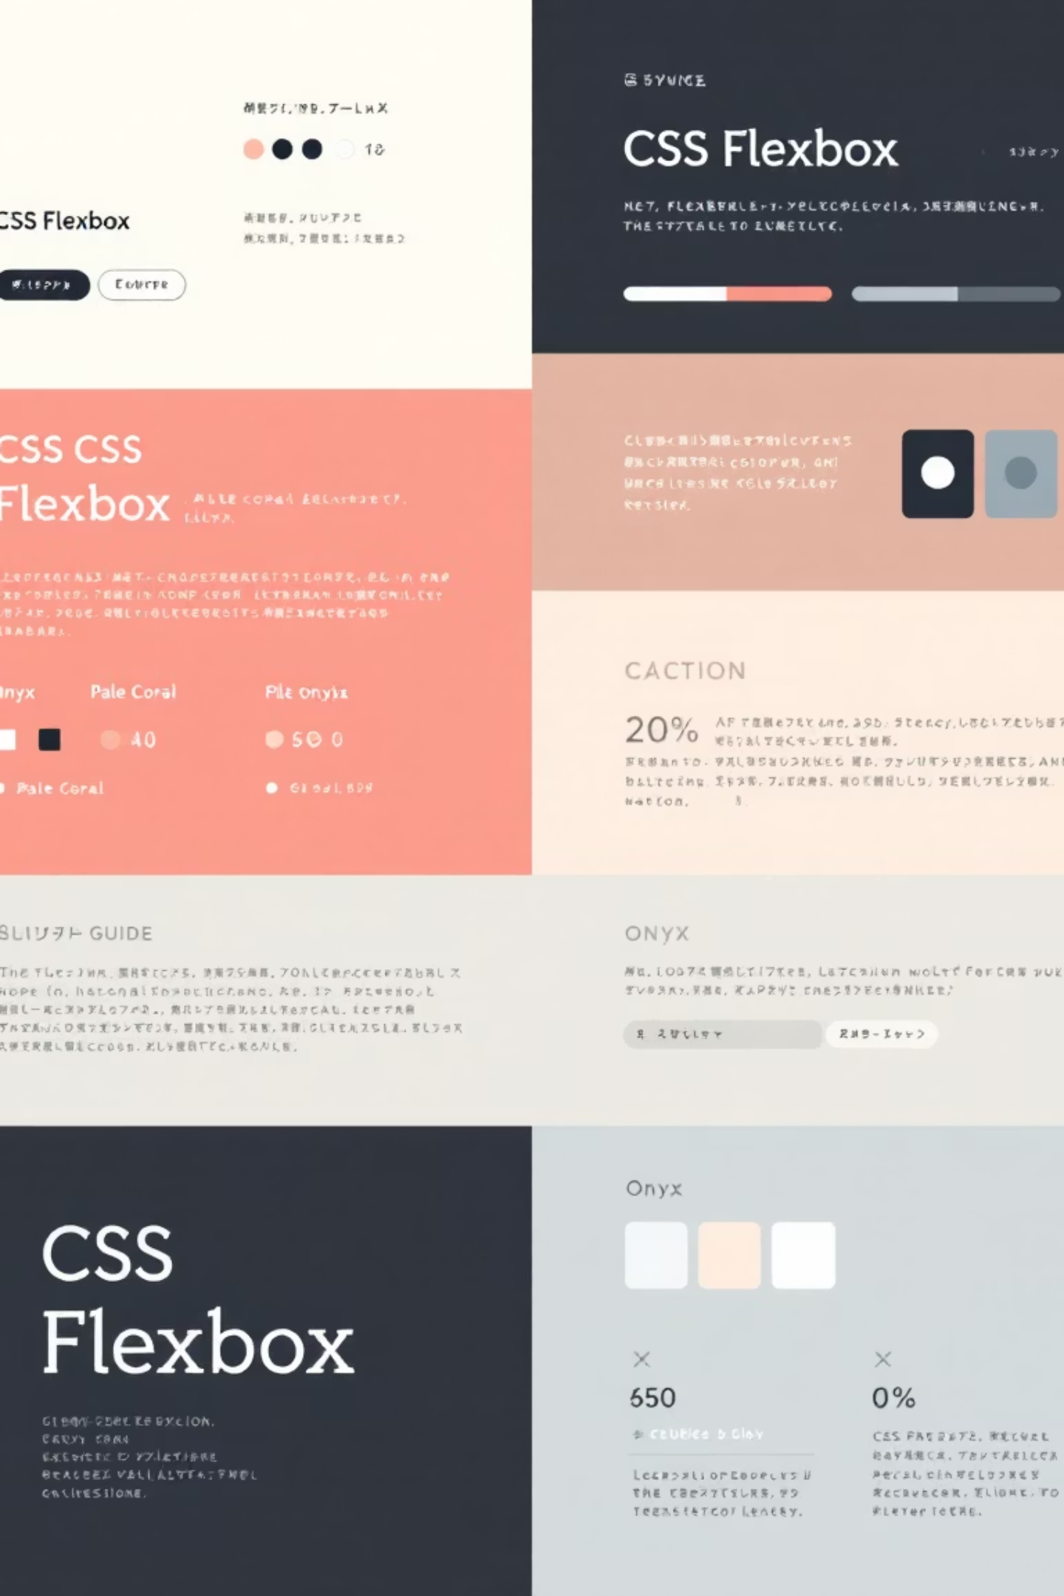
Key Takeaways
Flexbox simplifies modern layout challenges
No more float clearfixes or complex positioning - flexbox handles it elegantly.
Master the core container properties
flex-direction, justify-content, and align-items control most layouts.
Understand item flexibility
flex, align-self, and order give you fine-grained control.
Build responsive layouts with confidence
Flexbox is your foundation for creating modern, mobile-first web experiences.
Thank you for learning CSS Flexbox! Start implementing these techniques in your next project.

